Slide 1
CSE7302 - INTERNSHIP Review-2 Presentation FULL STACK DEVELOPMENT
Under the Supervision of,
Mr. H Senthil Kumar
Associate Professor
Presidency School of CSE
Presidency University
Student Details
Name | HARSHITH V
Roll No | 20221CSE0635
Section | 8CSE12
Name of the Program: Computer Science and Engineering
Name of the HoD: Dr. Asif Mohammed HB
Name of the Program Internship Coordinator: Mr. Sakthi S
Name of the School Internship Coordinator: Dr. Md Ziaur Rahman

Slide 2
Content
About Company or Organization
Working domain or the technology
About your team and reporting Manager
Challenges Faced in Internship
Objectives of the work
Literature Review
Proposed System
Problem Statement
System Requirements
Advantages of Proposed System/Work
Internship Roadmap
Github Link

Slide 3
About Company or Organization
Company / Organization Name: Rail Wheel Factory (RWF)
Organization Type: Government of India Enterprise (Under Ministry of Railways)
Location: Yelahanka, Bengaluru, Karnataka
Overview: It is one of the major factories that manufactures railway wheels and axles for Indian Railways. These wheels are used in trains, metros, and coaches across the country. RWF plays an important role in keeping the railway system running smoothly and safely.

Slide 4
About Company or Organization
Along with manufacturing, RWF also has a strong IT and Systems Department. This department handles:
Digital records
Employee and production data
Internal software applications
Database management

Slide 5
About Company or Organization
RWF deals with a large amount of data like:
Employee details
Production records
Machine and process information
To manage all this data properly, software and databases are used. This is where applications built using Visual Basic and SQL are helpful, as they allow users to easily store, update, and retrieve information through a simple interface.

Slide 6
Working domain or the technology
Internship Domain: FULL-STACK DEVELOPMENT
Technologies Used:
Database: SQL Server
Backend: Python (Flask – REST API)
Frontend: ReactJS
API Testing: Postman
Version Control: GitHub

Slide 7
About your team and reporting Manager
About Your Team & Reporting Manager
Reporting Manager: Mr. Buddha Appa Rao, Senior Section Engineer (SSE) at Rail Wheel Factory.
Internship is conducted in batch.
All interns are trained together in a classroom-style setup.
No fixed project team yet.

Slide 8
Challenges Faced in Internship
Learning how database tables are connected
Dealing with missing or repeated data
Fixing errors while connecting the system
Linking frontend with backend
Making sure data stays correct everywhere

Slide 9
Objectives of the work
To develop a web-based reporting system
To design REST APIs using Flask
To connect the backend with the SQL Server database
To retrieve and display data using APIs
To reduce manual report preparation
To improve data accuracy and consistency
To understand full-stack application workflow

Slide 10
Literature Review
Most Hospitals still use basic or old software systems that are
not equip for multiple entity set up.
Report generation usually takes more time.
Data is often stored in different places.
Data duplication and errors are common.
Web-based systems make access easier.
Flask and React are popular for such applications.

Slide 11
Proposed System / Work
Web-based Hospital management system.
Backend using Flask REST APIs.
SQL Server for data storage.
ReactJS for the user interface.
APIs for data retrieval and reports.
Centralized database system.
Faster and structured report generation.

Slide 12
Problem Statement
To design and develop a API for the Hospital Management System to handle data efficiently and make the data structured and easy to access.
Existing systems are slow
Reports take more time to generate
Data is not fully centralized
Manual work causes errors
Need for web-based API system

Slide 13
System Requirements
Hardware Requirements
Computer / Laptop
Processor: Intel i3 / i5 or above
RAM: Minimum 8 GB
Storage: At least 50 GB free space
Internet connection
Software Requirements
Operating System: Windows
Backend: Python, Flask
Database: SQL Server
Frontend: ReactJS
Tools: VS Code, Postman
Browser: Chrome / Edge

Slide 14
Advantages of Proposed System/Work
Faster report generation
Reduces manual work
Better data accuracy
Centralized data system
Easy to maintain and update
Scalable for future features
Overall work becomes faster and smoother.

Slide 15
Internship Road Map
Note: Write in the below table what u will be achieving in each review
Review 1
10/1/2026-16/1/2026
OVER VIEW OF WHAT WILL BE DONE.
Review 2
31/01/2026-06/02/2026
THE DESIGN AND DEMO OF THE BACKEND DATA RETRIVAL.
Review 3
Review 4
Final Review
03/04/2026-09/04/2026
WORKING MODEL OF THE SAME.
20/04/2026-26/04/2026
28/02/2026-
06/03/2026
FULLY FUNTIONAL FRONTEND.

Slide 16
Github Link
https://github.com/meharshithv14-ctrl/INTERNSHIP

Slide 17
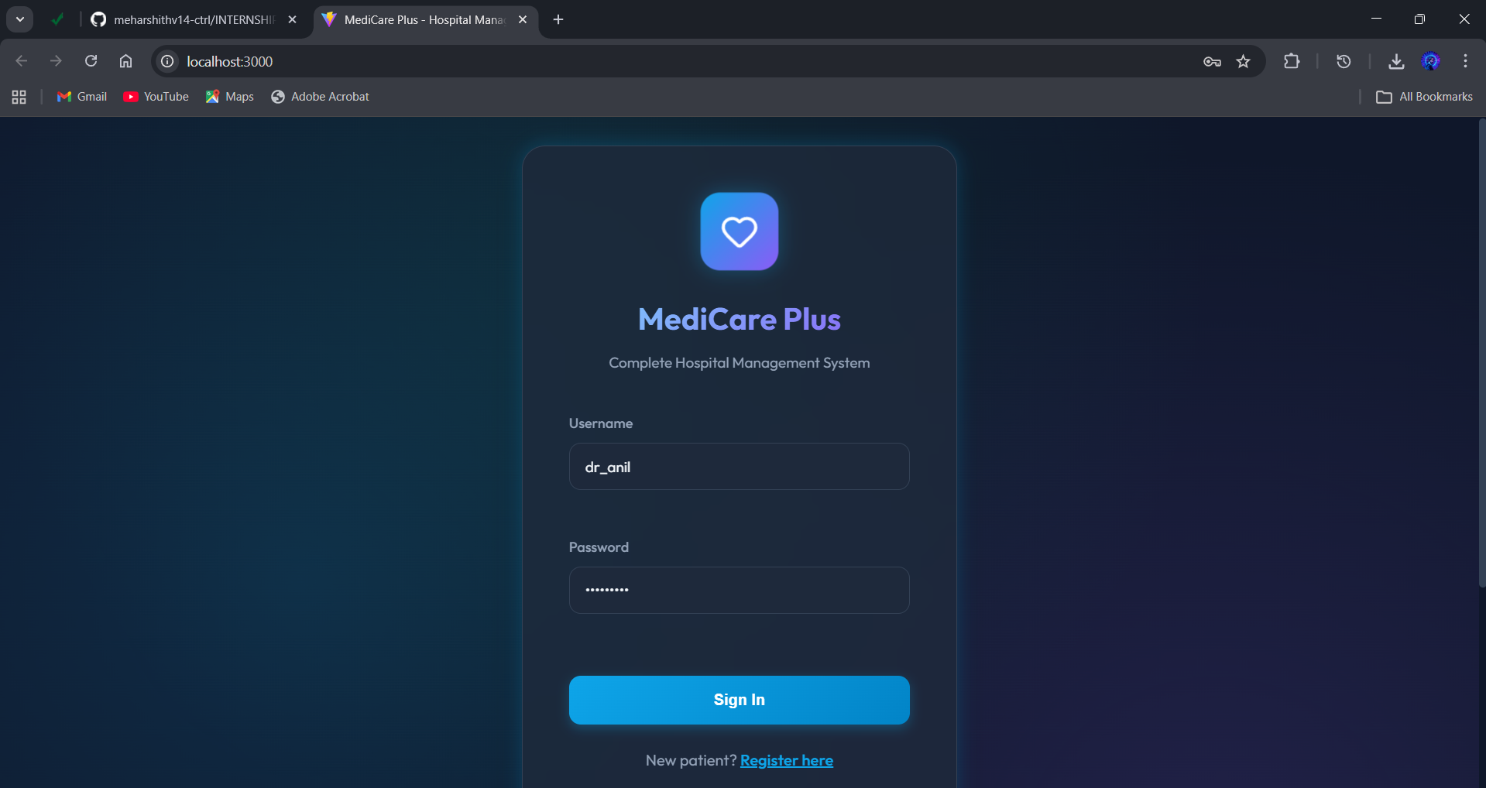

Slide 18
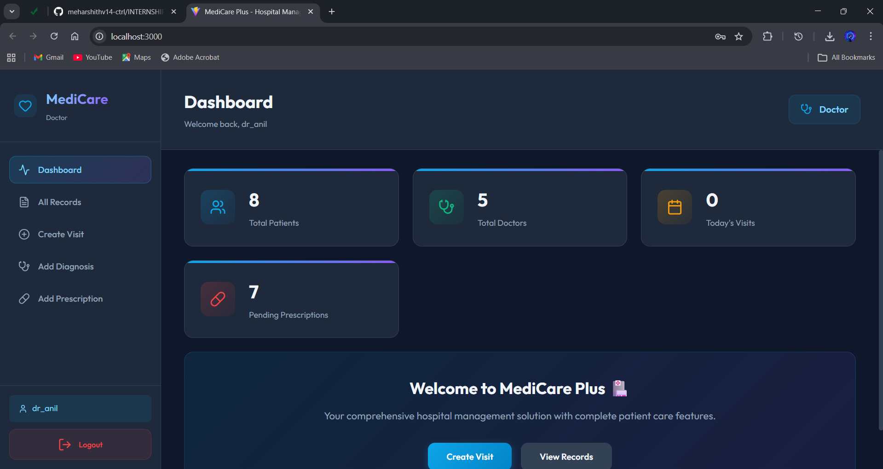

Slide 19
Q&A

Slide 20
Thank you !!

